Slide 1
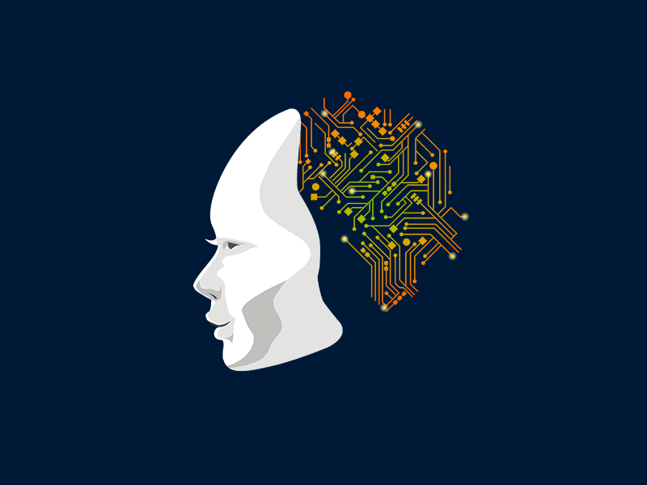
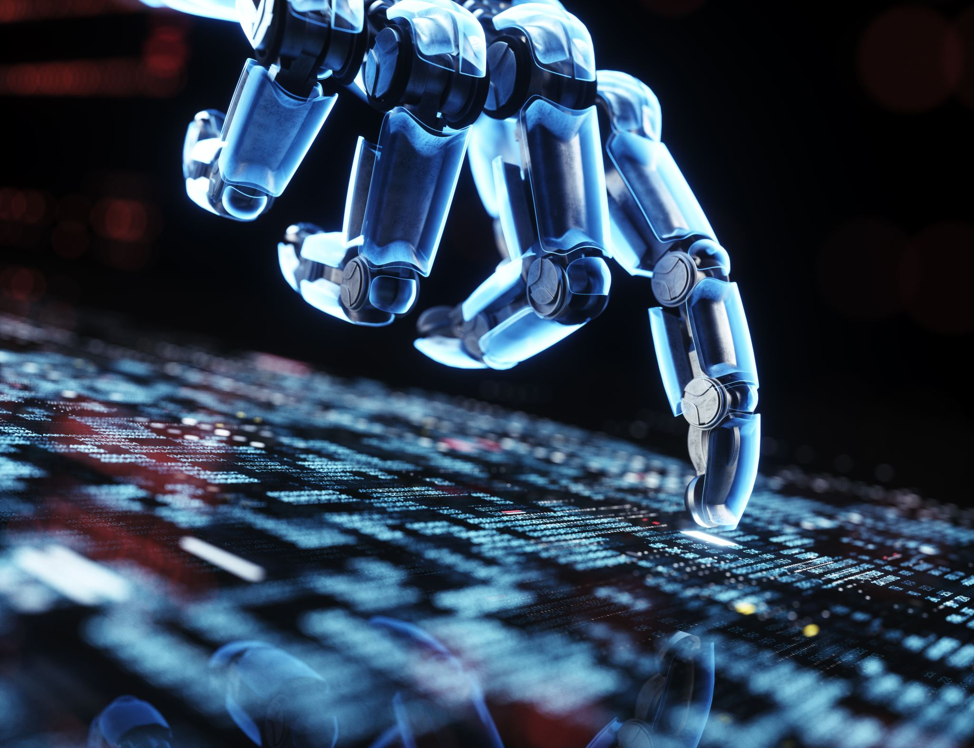

Introduction
Introduction to Artificial Intelligence
How machines recognize patterns
Introduction to Machine Learning concepts
Supervised vs Unsupervised Learning
Types of ML problems (Classification & Regression)
Basic Machine Learning algorithms
Linear Regression overview with examples
Notes:
Hi Team,
As scheduled, we will be meeting for our upcoming session on Artificial Intelligence and Machine Learning.
During this session, we will cover:
• Introduction to Artificial Intelligence • Where AI is used in real-world industries • Difference between AI, Machine Learning, and Deep Learning • How machines recognize patterns • Introduction to Machine Learning concepts • Supervised vs Unsupervised Learning • Types of ML problems (Classification & Regression) • Basic Machine Learning algorithms • Linear Regression overview with examples
The goal of this session is to build a clear foundation and practical understanding of how machine learning systems work.
Please make sure to join on time and feel free to bring any questions.
Looking forward to an engaging session.

Slide 2
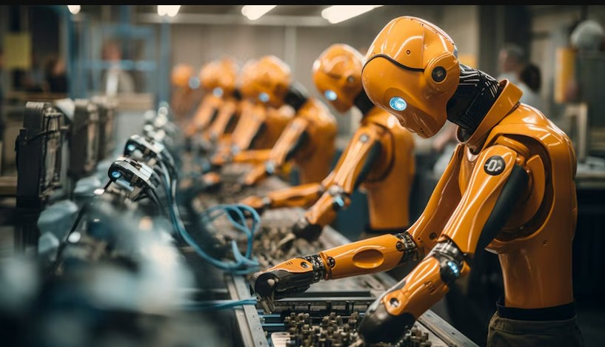
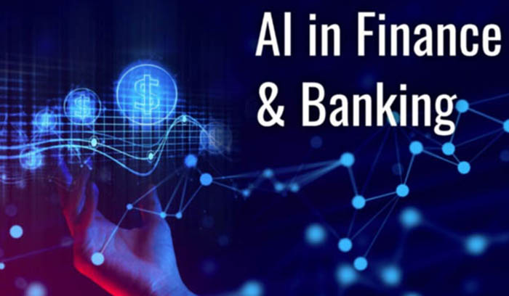
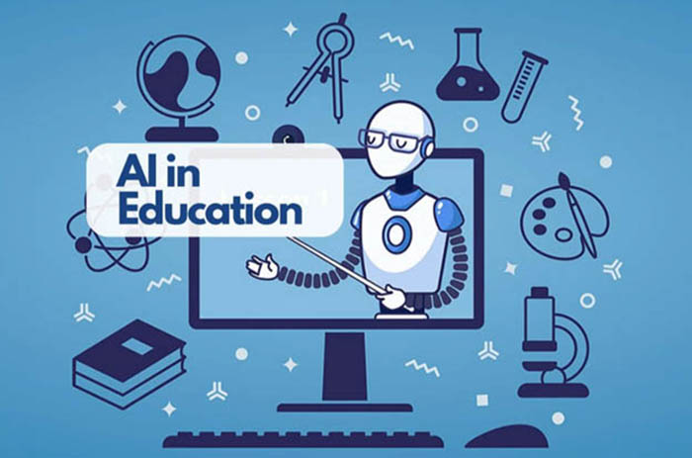
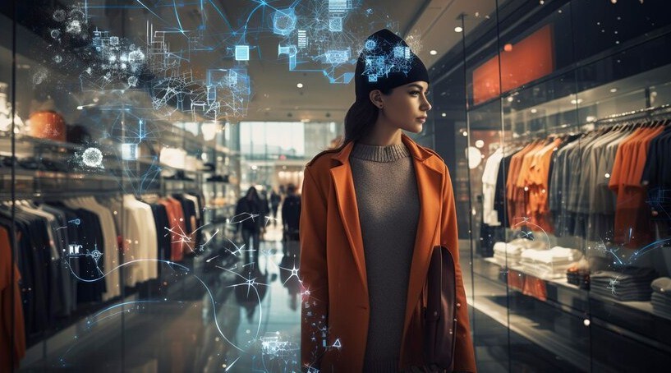
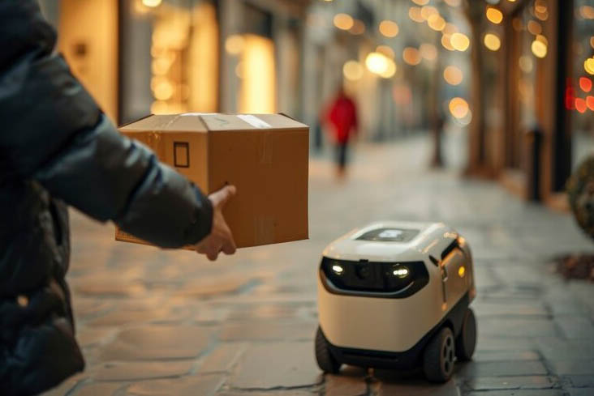
Where is AI used?
Notes:
Education –possibly for tutoring, personalized learning, or administrative automation.
Manufacturing & Automation – Depicted by robotic arms in an industrial setting, suggesting AI-driven automation in factories.
Finance & Banking – Labeled explicitly, likely referring to AI applications in fraud detection, algorithmic trading, credit risk assessment, and customer service chatbots.
Retail & Shopping – A futuristic AI-driven retail experience, indicating AI-driven customer insights, smart recommendations, or supply chain optimization.
Logistics & Delivery – A small autonomous delivery robot handing over a package, signifying AI-powered logistics, last-mile delivery, and smart routing.
1. Medical Imaging Analysis
Generative AI can enhance medical imaging analysis by generating high-resolution images from low-quality inputs. This technology assists radiologists in obtaining more straightforward and precise visualizations of medical scans, aiding in detecting and diagnosing diseases such as cancer, fractures, and neurological disorders.
2. Synthetic Data Generation
Training AI algorithms requires vast data, but accessing real patient information can raise privacy concerns. Generative AI can help overcome this challenge by creating synthetic data that closely mimics real-world medical data. This synthetic data can be used to train AI models effectively, without compromising patient privacy.
3. Drug Discovery
The drug discovery process can be lengthy and expensive. Generative AI accelerates this process by generating potential molecular structures with specific properties, such as drug efficacy and safety. This assists pharmaceutical researchers in identifying promising drug candidates, saving time and resources.
4. Personalized Treatment Plans
Generative AI can analyze patient data, including medical history and genetic information, to create personalized treatment plans. By considering individual variations, AI can suggest optimized treatment options with a higher likelihood of success and fewer side effects.
5. Disease Progression Modeling
Understanding how diseases progress is essential for effective treatment and patient management. Generative AI can simulate disease progression models based on historical patient data, enabling medical professionals to anticipate disease patterns and improve decision-making.
6. Medical Text Generation
Generating accurate medical reports and summaries can be time-consuming for healthcare providers. Generative AI can automate this process by generating detailed medical texts based on patient data and clinical findings, enhancing the efficiency of medical documentation.
7. Augmented Reality for Surgery
Incorporating Generative AI with augmented reality (AR) technology allows surgeons to access real-time guidance during complex procedures. AR overlays generated by AI in the surgical field can display critical information, such as organ structures and blood flow, assisting surgeons in making precise decisions.
8. Mental Health Support
Generative AI can contribute to mental health care by generating virtual assistants that simulate human-like conversations. These AI companions can provide round-the-clock support, monitor patients’ emotional well-being, and offer appropriate responses or interventions.
9. Rehabilitation and Prosthetics
Generative AI-powered exoskeletons and prosthetics can be tailored to individual patients’ needs. By analyzing movement patterns and medical history, AI can design personalized assistive devices that enhance mobility and improve the quality of life for individuals with physical disabilities.
10. Predictive Analytics
Generative AI can aid in predictive analytics for various healthcare scenarios. By analyzing vast amounts of patient data, AI can predict disease outbreaks, patient readmissions, and other critical events, allowing healthcare facilities to be better prepared and allocate resources more efficiently.
AI in Retail and E-commerce
Personalized Product Recommendations
AI-driven recommendation engines personalize every customer’s shopping journey across websites, mobile apps, email, digital ads, and in-stores.
These systems analyze behavioral signals like browsing activity, purchases, clicks, swipes, and product views to surface the most relevant recommendations for each shopper dynamically.
When customers receive AI-tailored recommendations for items they’re truly interested in, it boosts engagement, conversions, average order value, and lifetime loyalty.
AI’s self-learning algorithms get smarter at personalizing experiences over time and with more data.
Demand Forecasting & Dynamic Pricing
Fueled by machine learning predictions, retailers use AI systems to produce accurate forecasts for future product demand based on complex data inputs like sales histories, inventory levels, pricing details, promotional calendars, economic factors, and others.
Combining demand forecasts with real-time market data empowers dynamic pricing models to automatically adjust sticker prices up or down to maximize revenue potential, clear aging stock, or remain competitive.
AI also guides promotion planning and markdown cadence decisions.
AI in Manufacturing
Predictive Maintenance
By continuously monitoring Internet of Things (IoT) sensor data from factory equipment and production line machinery, AI systems can predictively determine when assets will likely require repair or replacement to avoid unexpected downtime incidents.
Predictive alerts provide time to schedule maintenance proactively at opportune times rather than reactively after breakdowns occur.
Automated Quality Control
Computer vision AI is enhancing quality assurance and quality control measures across manufacturing by automatically inspecting products, components, asset conditions, and processes for defects in real time at superhuman scales.
High-resolution cameras integrated with machine learning models rapidly detect even minuscule surface imperfections, dents, cracks, contaminations, or missing pieces that may have passed by human quality inspectors.
AI vision empowers 100% automated inspection for quality standards traceability.
Autonomous Vehicles and Mobility
While not yet mainstream, autonomous vehicles and mobility solutions enabled by AI are actively being developed and tested across passenger transportation, trucking, and last-mile delivery domains.
AI computer vision models interpret real-time visual data from cameras and sensors to identify obstacles, traffic signals, pedestrians, and environmental conditions.
Machine learning handles the core navigation and vehicle control decision systems to dynamically plan paths and operate vehicles safely without human intervention.
Beyond technological milestones, AI will also power mobility services by coordinating fleets of autonomous trucks, taxis, and delivery vehicles through intelligent routing and traffic pattern optimization.
Understanding what industries use artificial intelligence helps identify opportunities for innovation and optimization.
Personalized Learning
Through machine learning and data analysis, AI systems can dynamically adapt educational content delivery, pacing, teaching styles, and learning activities to align with each student’s needs, aptitudes, and optimal learning pathways. That’s why AI in personalized learning is no longer a dream.
AI tutoring systems provide infinite patience, assessing knowledge gaps and strengths to customize curricula and recommend supplementary resources.
AI virtual teaching assistants offer 24/7 on-demand homework support tailored to how each student learns best.
Automated Grading and Feedback
Using AI for automated grading and feedback alleviates tedious workloads for educators.
Machine learning models can score tests, essays, programming assignments, and other subjective work as accurately as human graders.
But AI goes beyond just scores – it provides detailed, tailored feedback highlighting areas for improvement and explaining the rationale behind scoring decisions.
This scalable approach keeps teachers focused on higher-level tasks.
The integration of AI use cases in major industries is accelerating digital transformation solutions, enabling organizations to stay competitive in today’s rapidly evolving market.

Slide 3
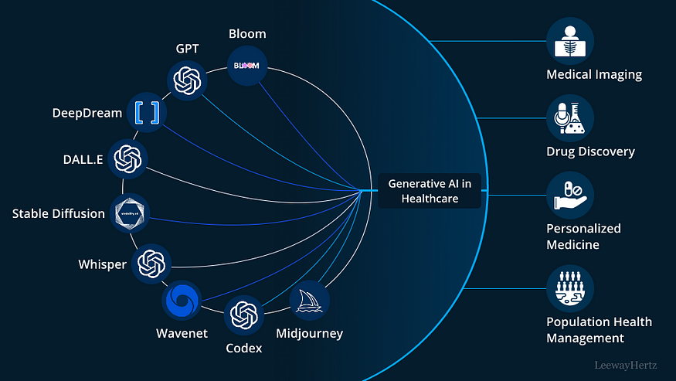
Where is AI used?
Notes:
Sora (OpenAI)
GPT (Generative Pre-trained Transformer)
Purpose: A natural language processing model that generates human-like text. Used for chatbots, content creation, summarization, and text-based AI applications.
Bloom
Purpose: A large open-source multilingual AI model similar to GPT. It is designed for text generation, translation, and various NLP tasks.
DeepDream
Purpose: A deep learning model by Google that enhances and modifies images to create dream-like, psychedelic visual effects. Used in artistic image generation.
DALL·E
Purpose: An AI model that generates images from textual descriptions. It is used in creative design, digital art, and visualization.
Stable Diffusion
Purpose: A deep learning model used for text-to-image generation. It allows for creating high-quality images based on user prompts.
Whisper
Purpose: An automatic speech recognition (ASR) model developed by OpenAI. It is used for transcribing spoken language into text.
Wavenet
Purpose: A deep generative model for creating human-like speech synthesis. Used in text-to-speech (TTS) applications.
Codex
Purpose: A code-generation AI model that helps programmers by generating code snippets from natural language prompts. It powers tools like GitHub Copilot.
MidJourney
Purpose: An AI-powered image-generation tool that specializes in creating artistic and detailed digital artworks from text descriptions.
Wavenet: What It Can Do
Wavenet is a deep generative model developed by DeepMind (Google) for generating high-quality, natural-sounding speech. It is a text-to-speech (TTS) synthesis model that significantly improves over traditional speech synthesis systems.
Key Capabilities of Wavenet:
Natural-Sounding Speech Generation
Wavenet generates realistic human-like speech with natural intonation and smooth transitions between words.
It captures the nuances of human speech better than traditional concatenative or parametric synthesis models.
Multi-Language & Multi-Speaker Support
It can generate speech in multiple languages and different voices with high clarity.
Can be trained on different speakers to mimic their voice styles.
Expressive Speech & Emotional Tone
Unlike traditional text-to-speech systems, Wavenet can inject emotions, pitch variations, and natural pauses, making the speech more engaging and lifelike.
Voice Cloning & Personalization
Wavenet can be used to clone and generate synthetic voices that sound almost identical to real human voices.
Used in applications like AI assistants, audiobooks, and automated call centers.
Text-to-Speech (TTS) Applications
Powers Google Assistant, Google Translate, and Google’s TTS API.
Used in voice assistants, customer service chatbots, and accessibility tools for visually impaired users.
Music & Sound Synthesis
Wavenet can generate raw audio waveforms beyond speech, making it useful for music and sound design applications.
Where is Wavenet Used?
Google Assistant & Voice AI → Improves digital assistant voices.
Google Translate → Provides natural-sounding translations in multiple languages.
Audiobooks & Podcasts → Converts text into high-quality spoken narration.
Customer Service Automation → Used in chatbots and IVR (Interactive Voice Response) systems.
Accessibility Tools → Helps visually impaired users by converting text into spoken words.
Why is Wavenet Better than Traditional TTS?
Unlike concatenative speech synthesis, which stitches together pre-recorded sound clips, Wavenet generates speech from scratch, making it more fluid and natural.
It models raw audio waveforms rather than relying on phonemes, making its speech more realistic.
Reduces robotic, unnatural sounds common in older TTS systems.
Applications in Healthcare:
These AI models contribute to various aspects of healthcare:
Medical Imaging
AI models assist in analyzing medical images like MRIs, X-rays, and CT scans, helping detect diseases early.
Drug Discovery
AI accelerates drug development by predicting molecular interactions, optimizing chemical structures, and reducing research time.
Personalized Medicine
AI tailors treatment plans based on a patient’s genetic profile and medical history for improved healthcare outcomes.
Population Health Management
AI analyzes health data from large populations to identify trends, predict disease outbreaks, and enhance healthcare planning.

Slide 4
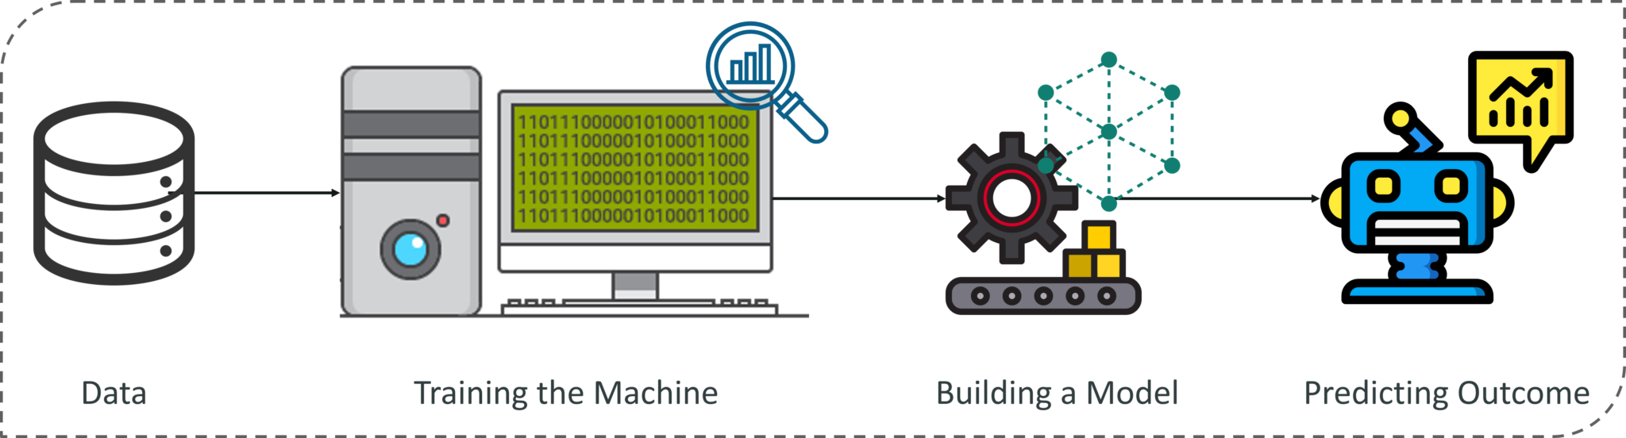
Introduction to machine learning
Machine learning is a branch of artificial intelligence that focuses on developing algorithms and models that enable computers to learn from and make predictions or decisions based on data.
It involves training machines to recognize patterns and make accurate predictions without being explicitly programmed.
Machine learning is used in various applications, including image recognition, natural language processing, and predictive analytics.

Slide 5

How the Human Eye Converts Light into Electrical Signals

Slide 6
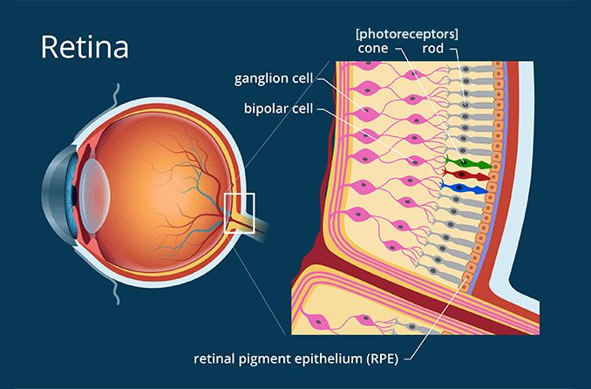
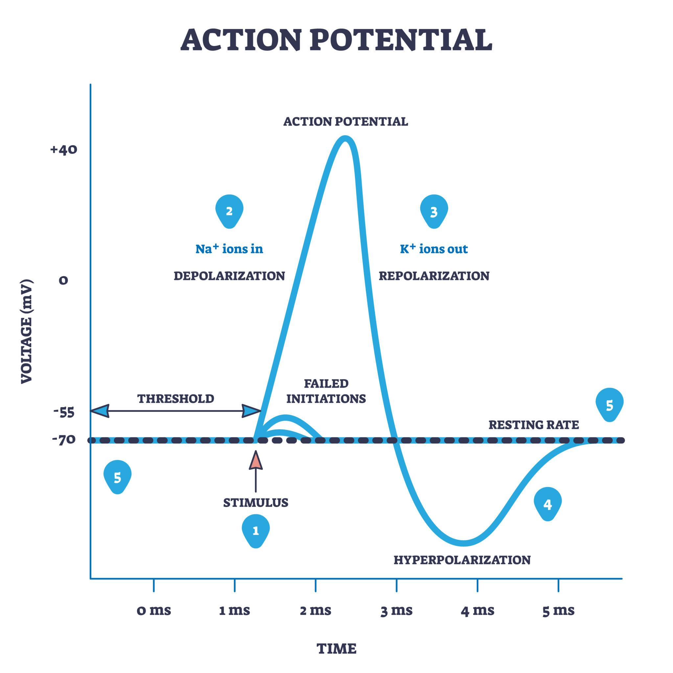
From Retina to Brain: Understanding Action Potentials
Light activates the pigment.
The cell’s electrical charge changes.
This changes how much neurotransmitter the cell releases.
Nearby neurons (bipolar → ganglion cells) respond.
Ganglion cells generate electrical impulses (action potentials).
Notes:
When light enters the eye and hits the rods or cones in the retina, it activates light-sensitive pigments inside those cells, causing a chemical reaction that changes the cell’s electrical charge. This electrical change alters how much neurotransmitter the photoreceptor releases onto nearby bipolar cells. The bipolar cells then adjust their own electrical activity and pass the signal to ganglion cells. Unlike rods and cones, ganglion cells generate true action potentials (spikes). These spikes travel along the optic nerve to the brain, where patterns of spike frequency and timing are interpreted as brightness, color, shape, and movement — allowing you to perceive an image.
What Is an Action Potential?
An action potential is a brief electrical pulse that travels down a neuron.

Slide 7
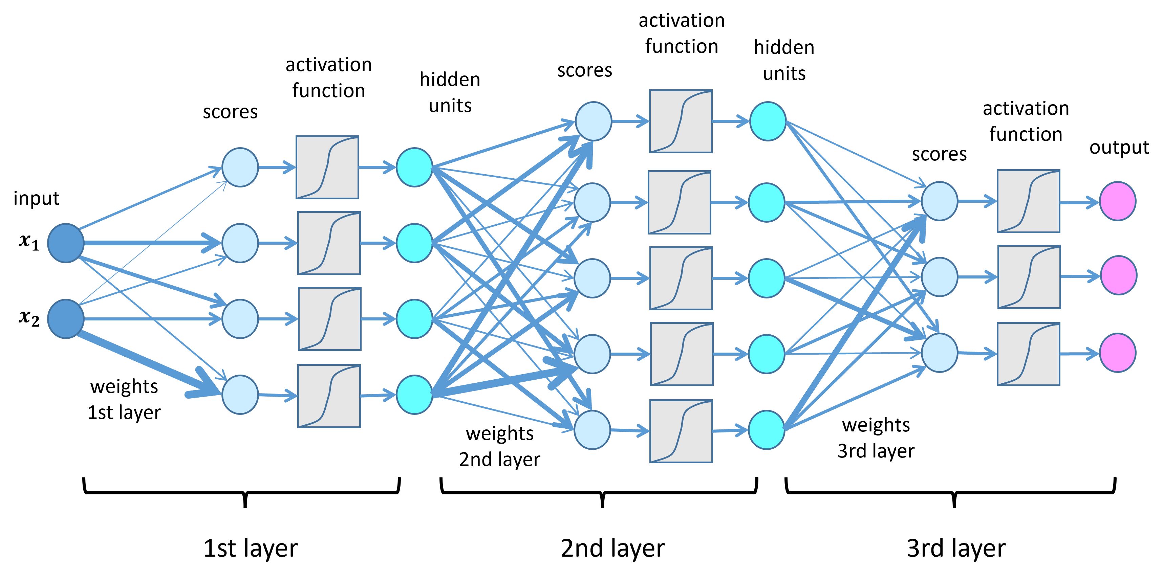
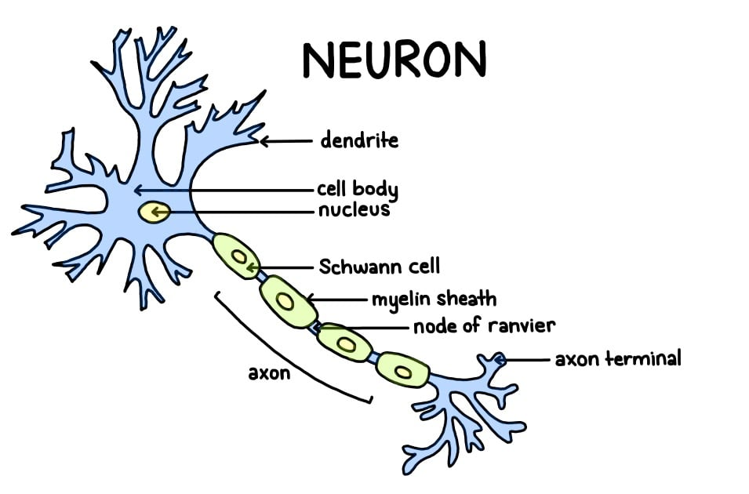
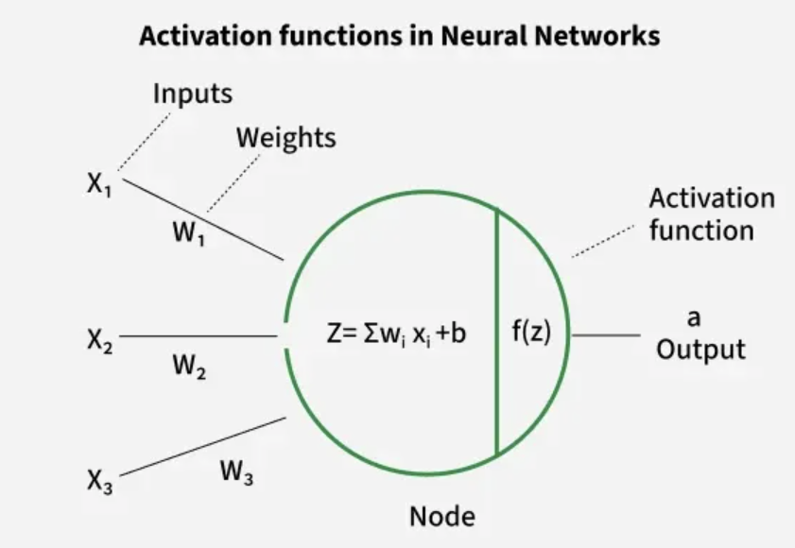
From Retina to Brain: Understanding Action Potentials
Biological Neuron | Deep Learning Equivalent
Dendrites receive signals | Inputs (x₁, x₂, x₃...)
Synapses have strength | Weights (w₁, w₂, w₃...)
Cell body sums signals | Weighted sum (Σ wᵢxᵢ)
Fires if threshold reached | Activation function
Axon sends signal | Output value

Slide 8
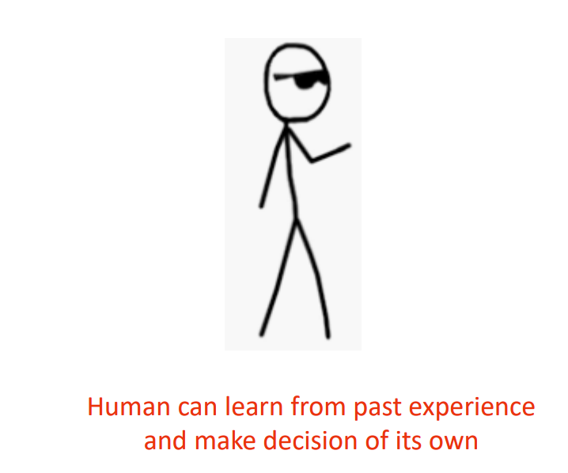

How exactly we recognize things

Slide 9
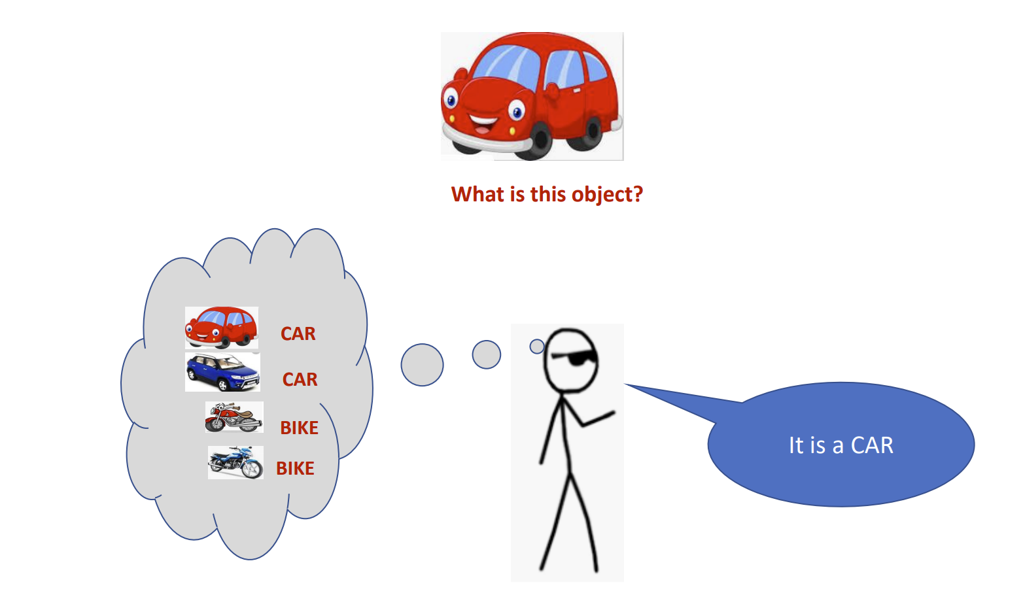
How exactly we recognize things

Slide 10
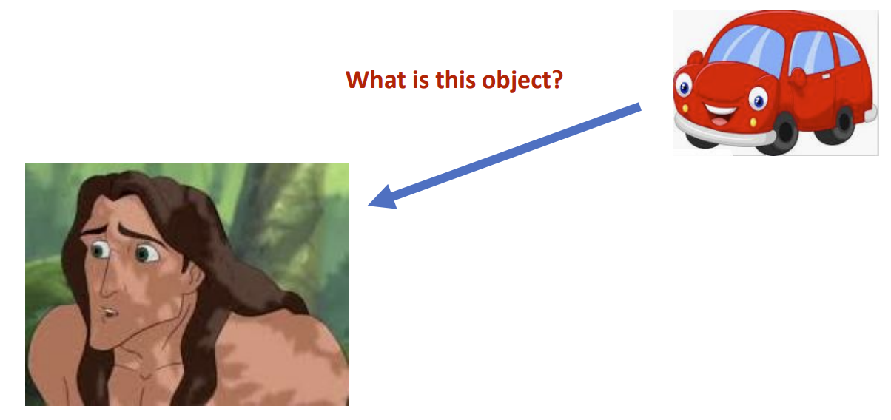
Let us ask the same question to him

Slide 11
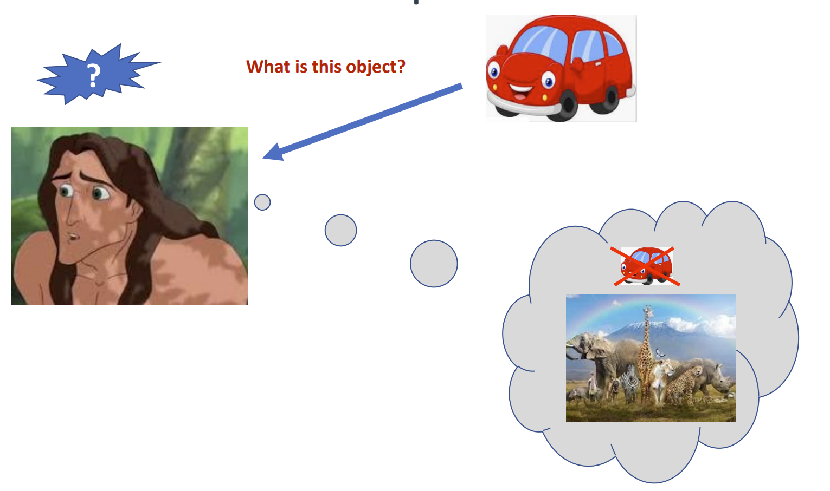
Let us ask the same question to him

Slide 12
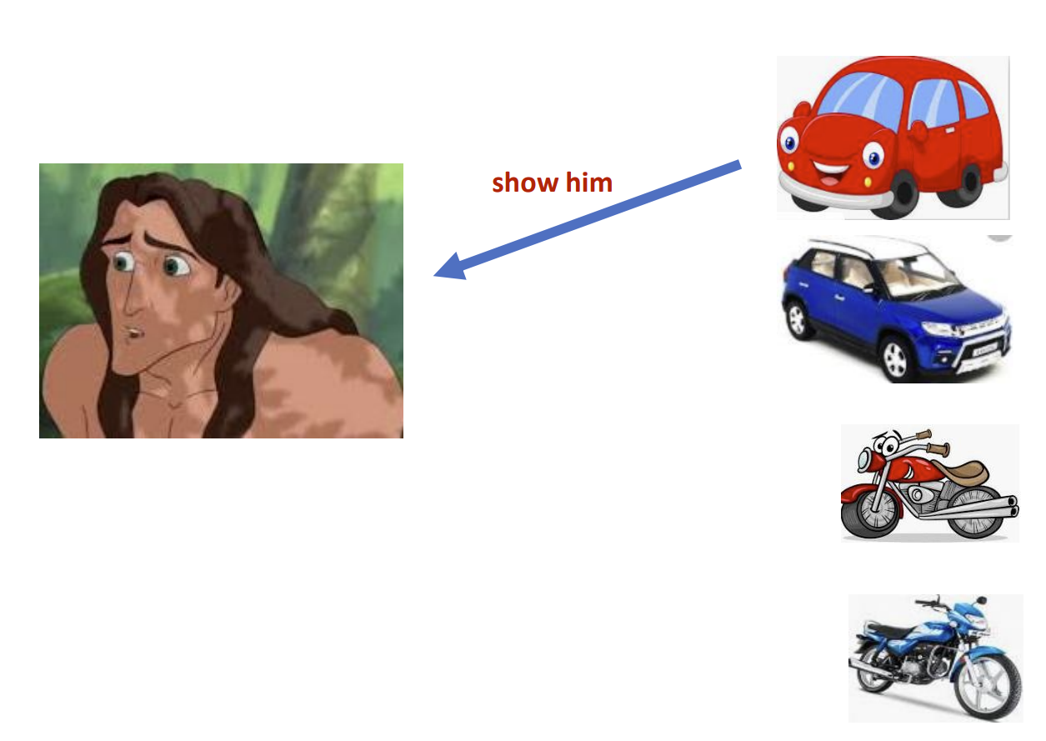
Let us make him learn

Slide 13
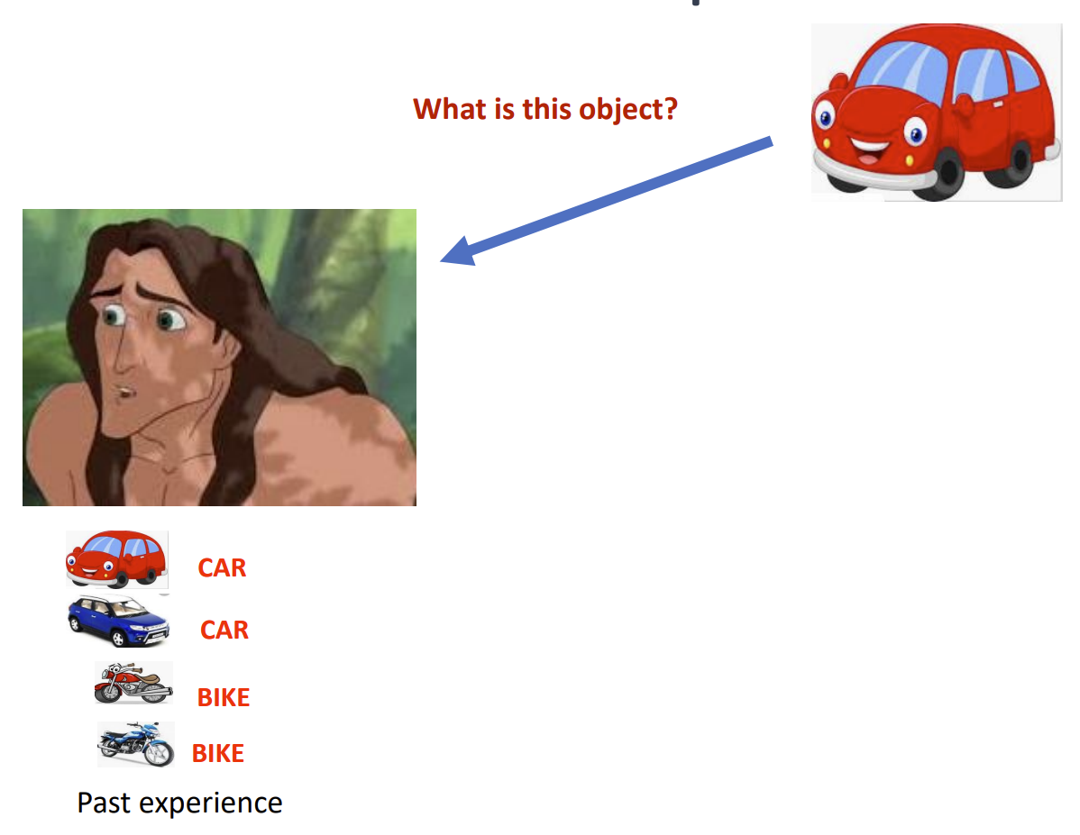
Let us ask the same question now

Slide 14
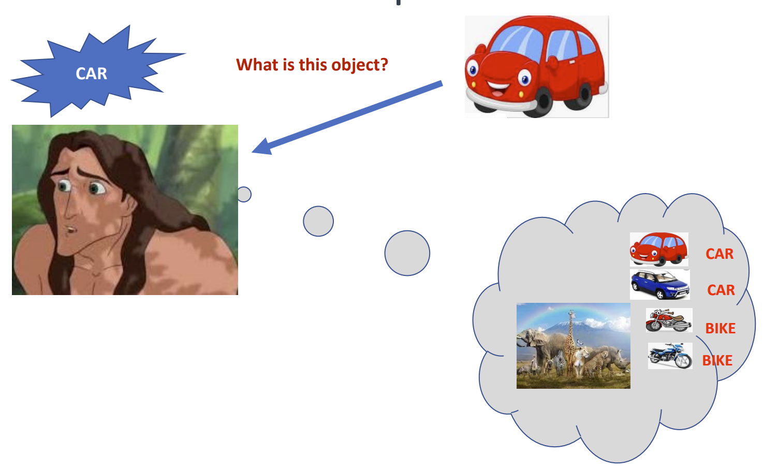
Let us ask the same question now

Slide 15
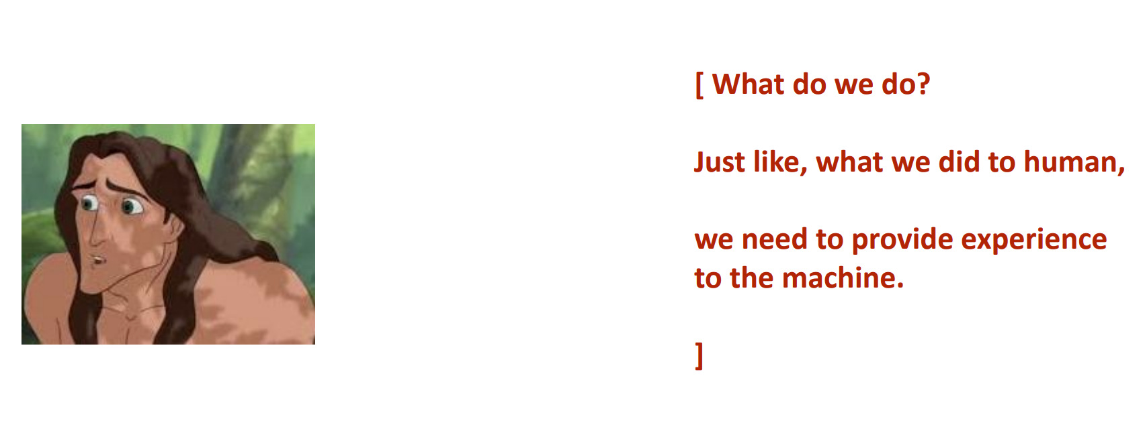
What is Machine Learning?

Slide 16
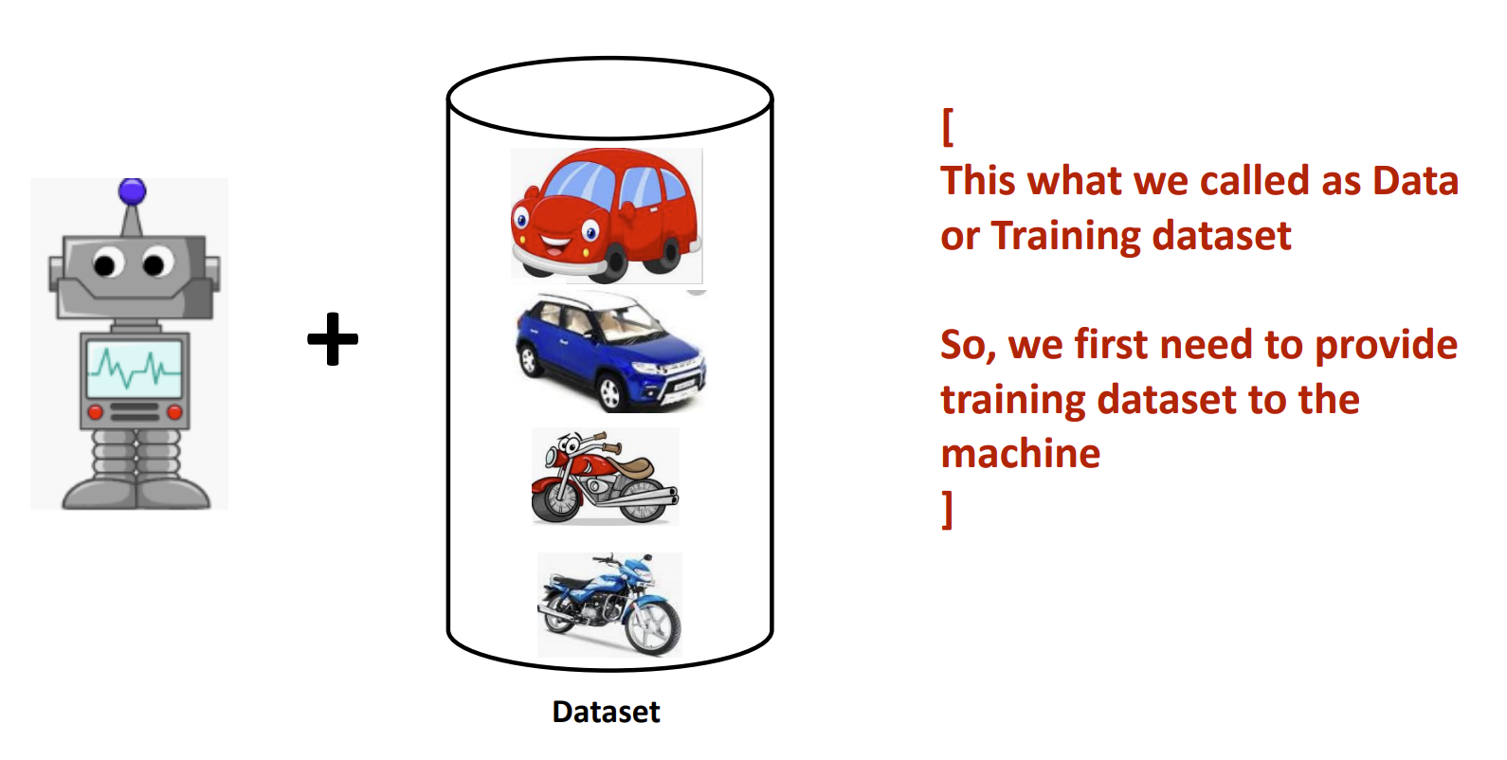
What is Machine Learning?

Slide 17
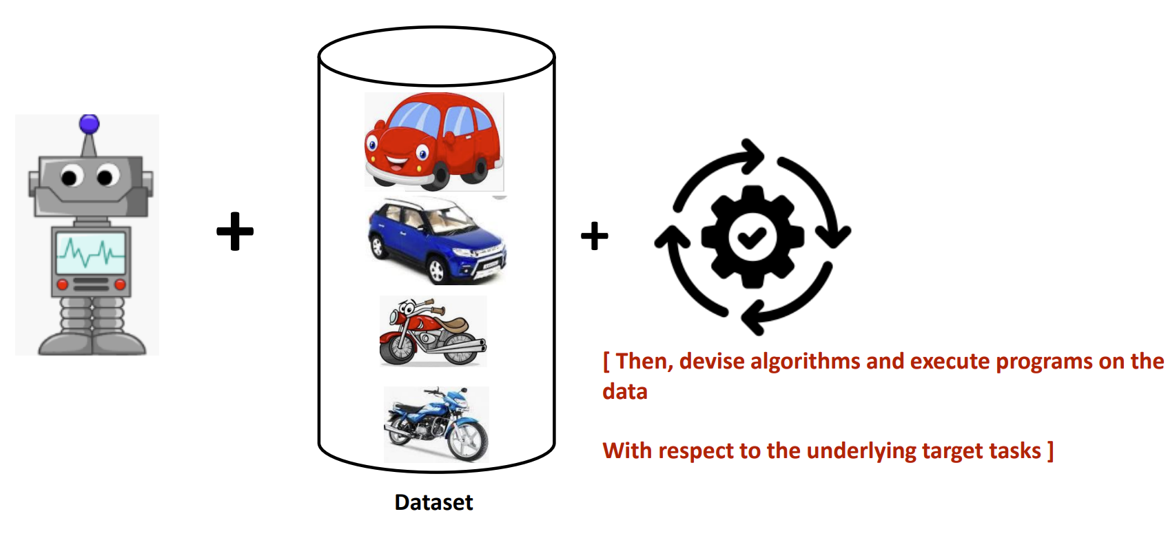
What is Machine Learning?

Slide 18

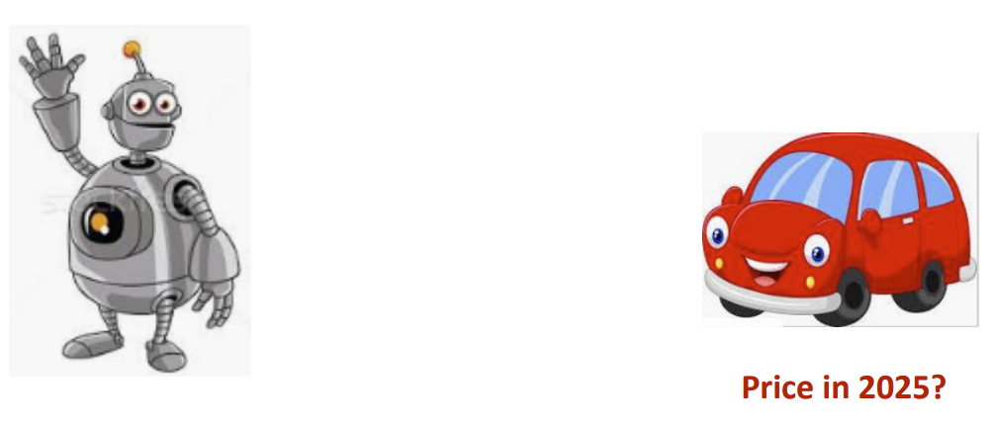
What is Machine Learning?
[ We want a machine to act like a human]
[ to identify this object.]
[ predict the price in future]

Slide 19
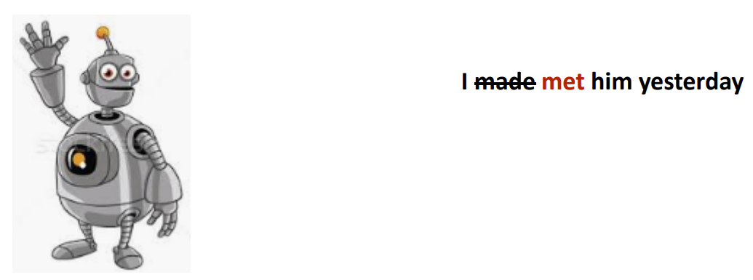
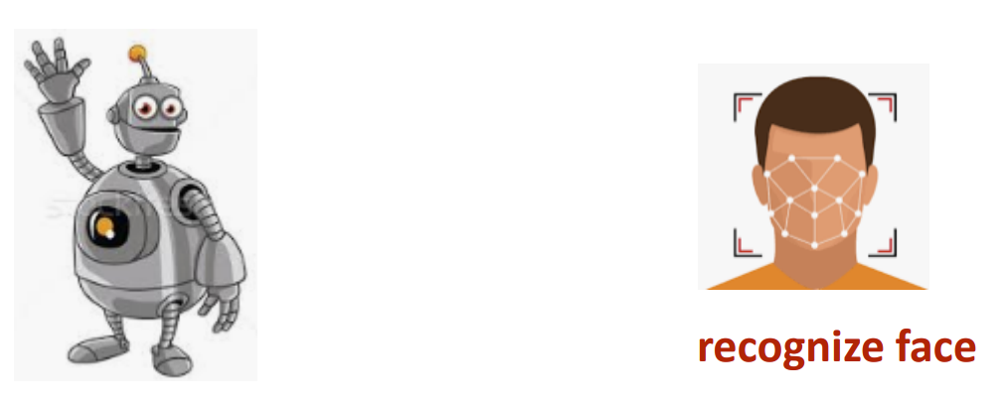
What is Machine Learning?
Natural Language understand, and correct grammar
[ Recognize Faces ]

Slide 20
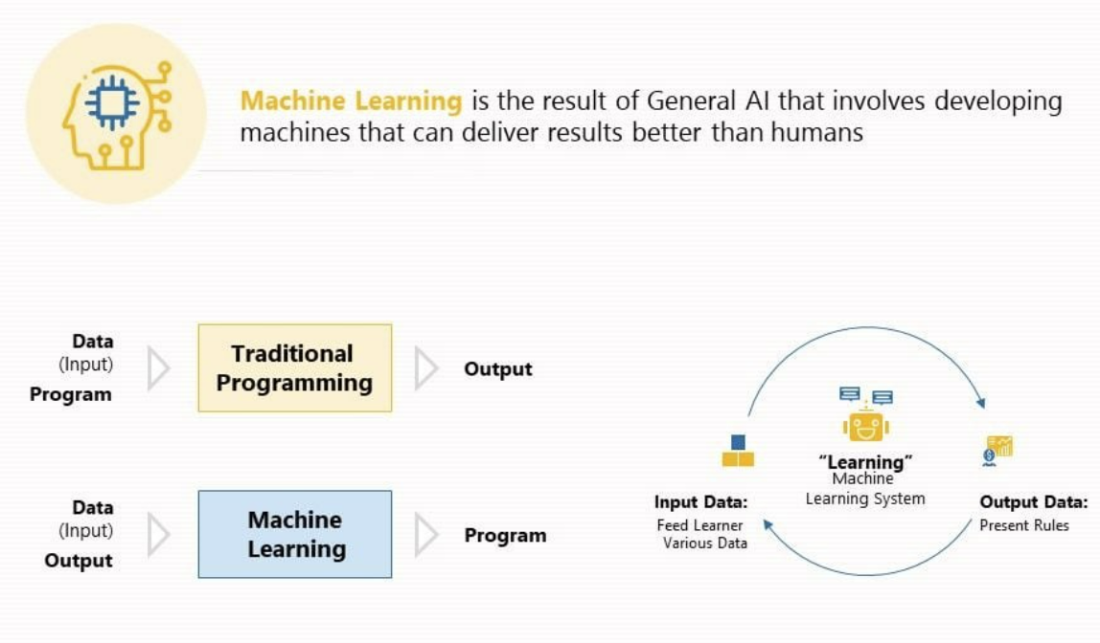
What is Machine Learning?
Notes:
Difference Between Traditional Programming and Machine Learning
Traditional Programming: Involves explicitly coding rules and logic to process data and generate an output. A human writes the program, provides the input, and the system produces a predefined output.
Machine Learning: Instead of manually programming rules, the system is trained on data. It identifies patterns, learns from experience, and generates a predictive model, which can then produce outputs for new data.
Process Flow of Traditional Programming
The system receives data (input) and follows predefined program logic to generate an output.
Process Flow of Machine Learning
The system is provided with input data and an expected output, and it learns from the data.
Instead of hard-coded rules, the machine generates a program (model) that can generalize and make decisions based on unseen data.
The learning system refines itself by adjusting its internal parameters to improve accuracy.

Slide 21
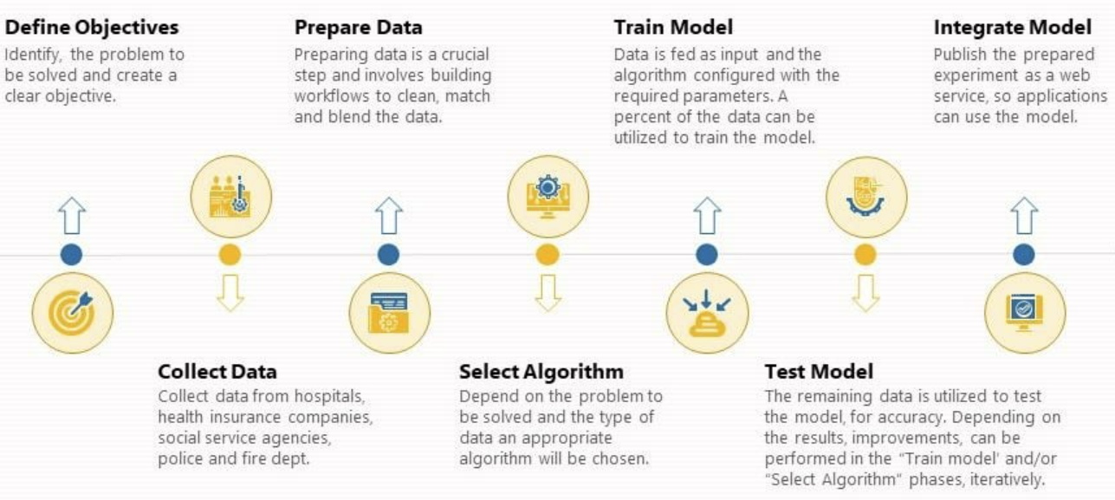
How does Machine Learning Work?

Slide 22
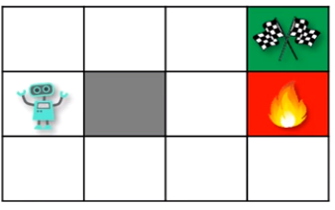
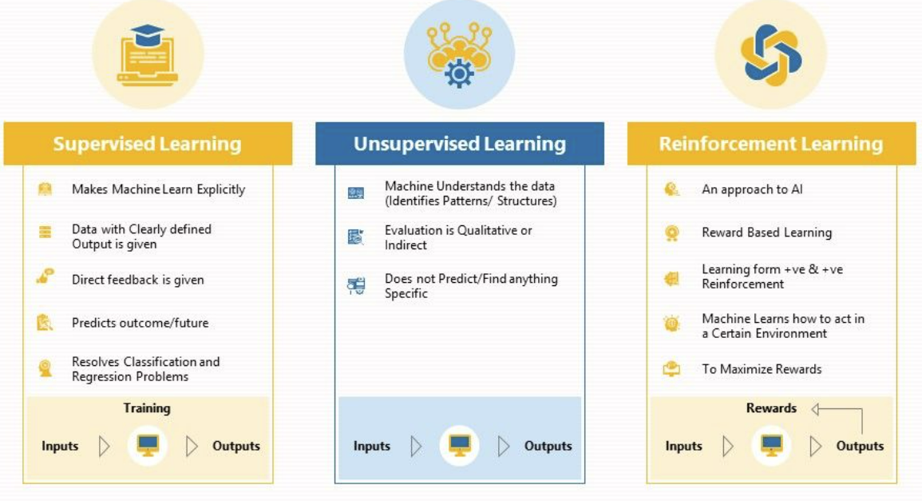
Steps in the Machine Learning Pipeline

Slide 23

Supervised Machine Learning
What is Supervised Machine Learning?
How Supervised Learning Works
Types of Supervised Machine Learning algorithms
Supervised vs Unsupervised Machine Learning techniques
Advantages of Supervised Learning
Disadvantages of Supervised Learning

Slide 24
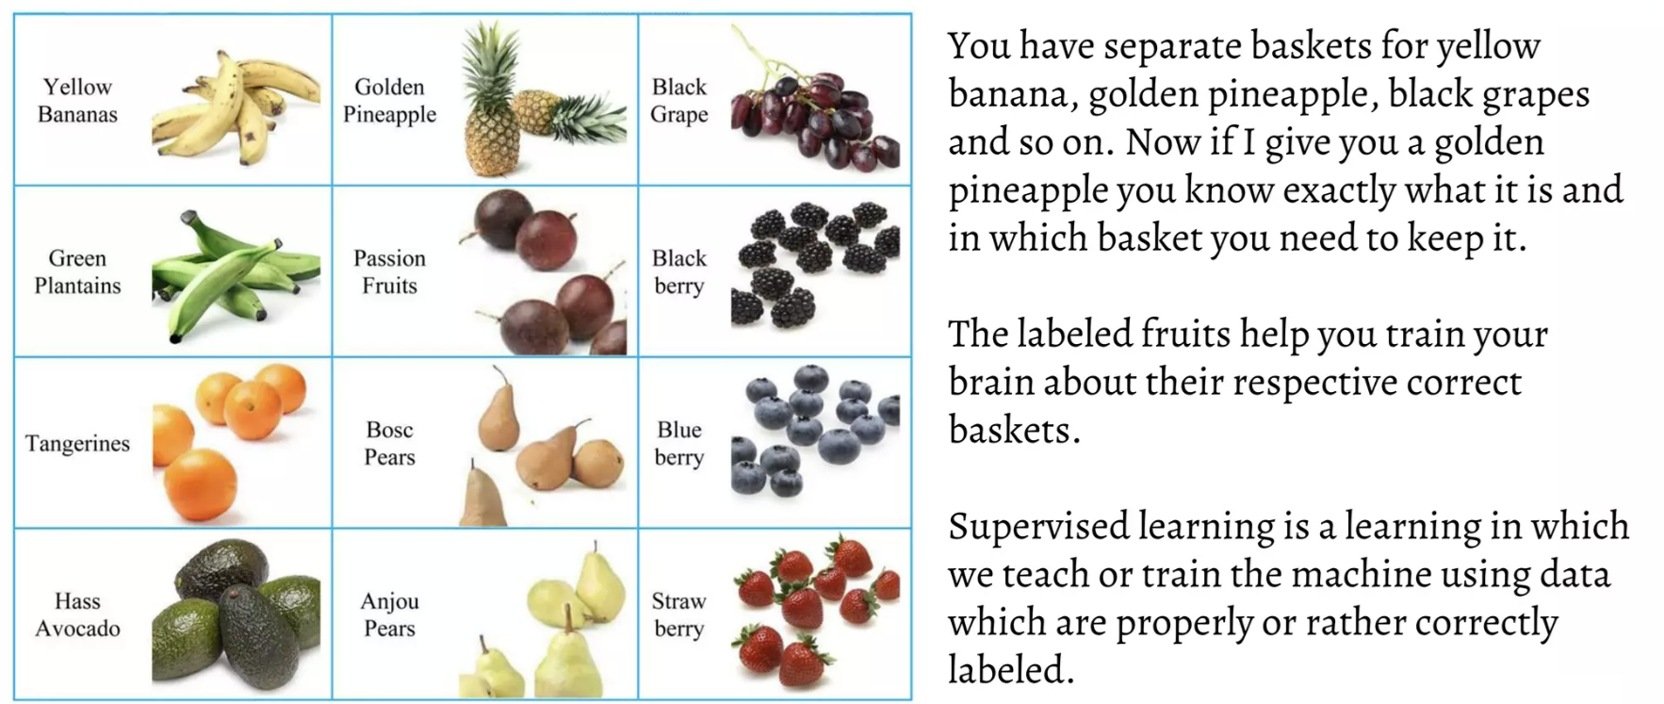
What is Supervised Learning

Slide 25
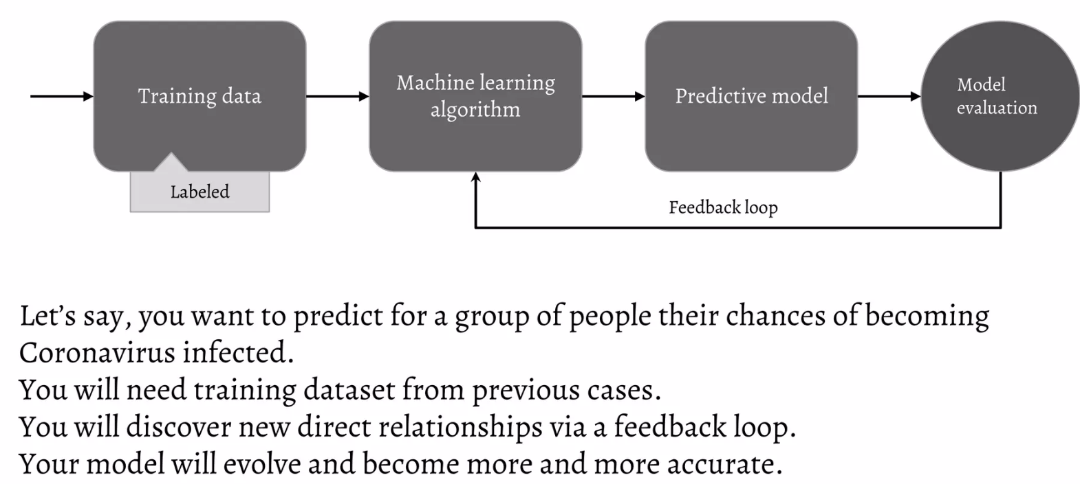
The supervised Learning Process
Notes:
It begins with Training Data, which consists of labeled examples from past cases. This data is then fed into a Machine Learning Algorithm, which learns patterns and relationships between input features and outcomes. The trained model then produces a Predictive Model, which can be used to make future predictions. The predictions undergo Model Evaluation, where the accuracy and performance of the model are assessed. A Feedback Loop ensures continuous improvement by refining the model based on new data and insights, allowing it to become more accurate over time.

Slide 26
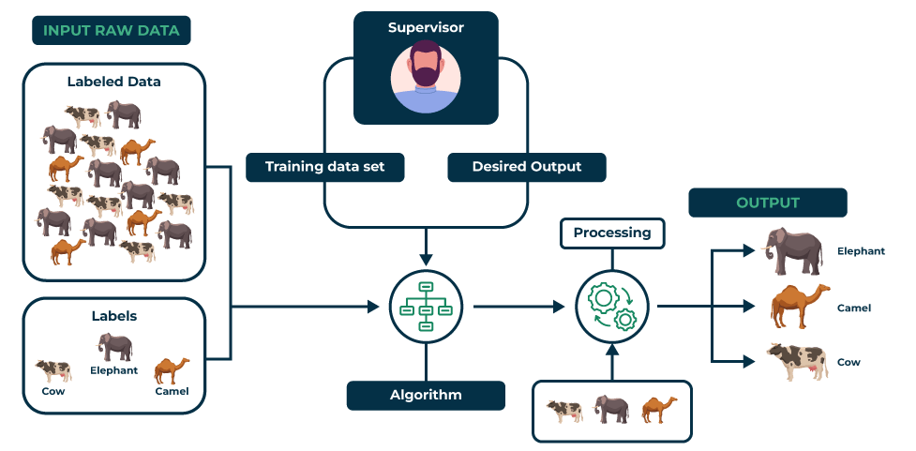
Supervised Learning: Animal Classification Example
Notes:
The diagram illustrates a supervised machine learning process using an animal classification example. It begins with input raw data, consisting of labeled data (images of cows, elephants, and camels) and their corresponding labels (Cow, Elephant, Camel). A supervisor oversees the process, defining the training dataset and the desired output.
The labeled training data is fed into a machine learning algorithm, which learns to recognize patterns and characteristics of each animal. After training, the algorithm undergoes a processing stage where new input images are classified based on learned patterns.
Finally, the model generates an output, categorizing new images into one of the three classes: Elephant, Camel, or Cow. This diagram highlights the fundamental steps of supervised learning—data collection, labeling, training, processing, and classification—leading to an effective predictive model.
4o

Slide 27

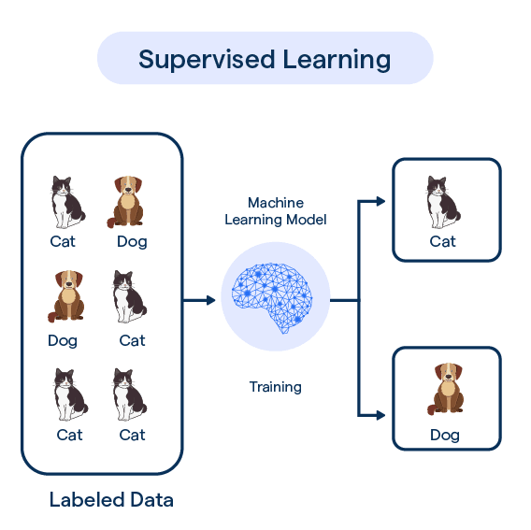
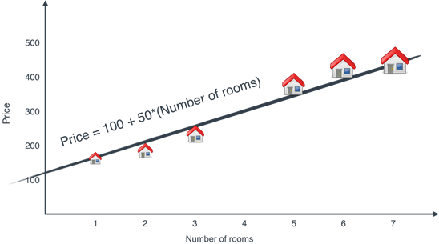
Types of problems
Classification
Regression
Notes:
https://colab.research.google.com/drive/1MP3d3MR4gzMXzGYTlN4kzJn6LVypr1X2#scrollTo=36o6yDxgIIM7

Slide 28
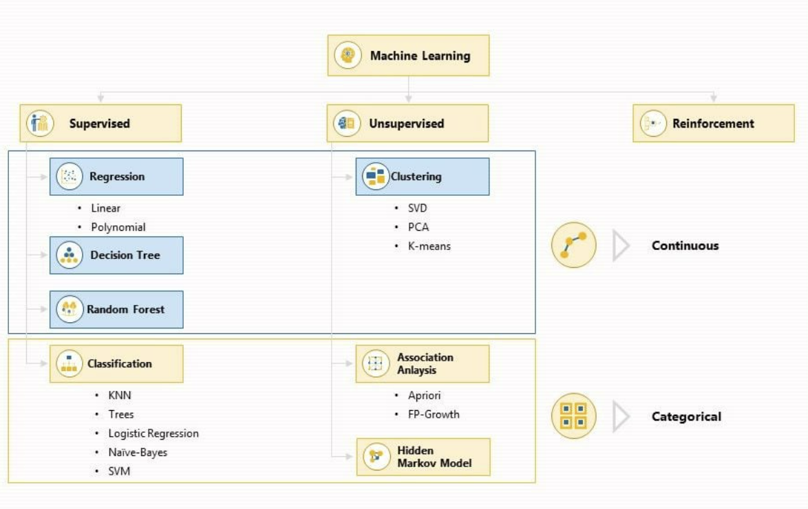
Machine Learning Algorithms

Slide 29
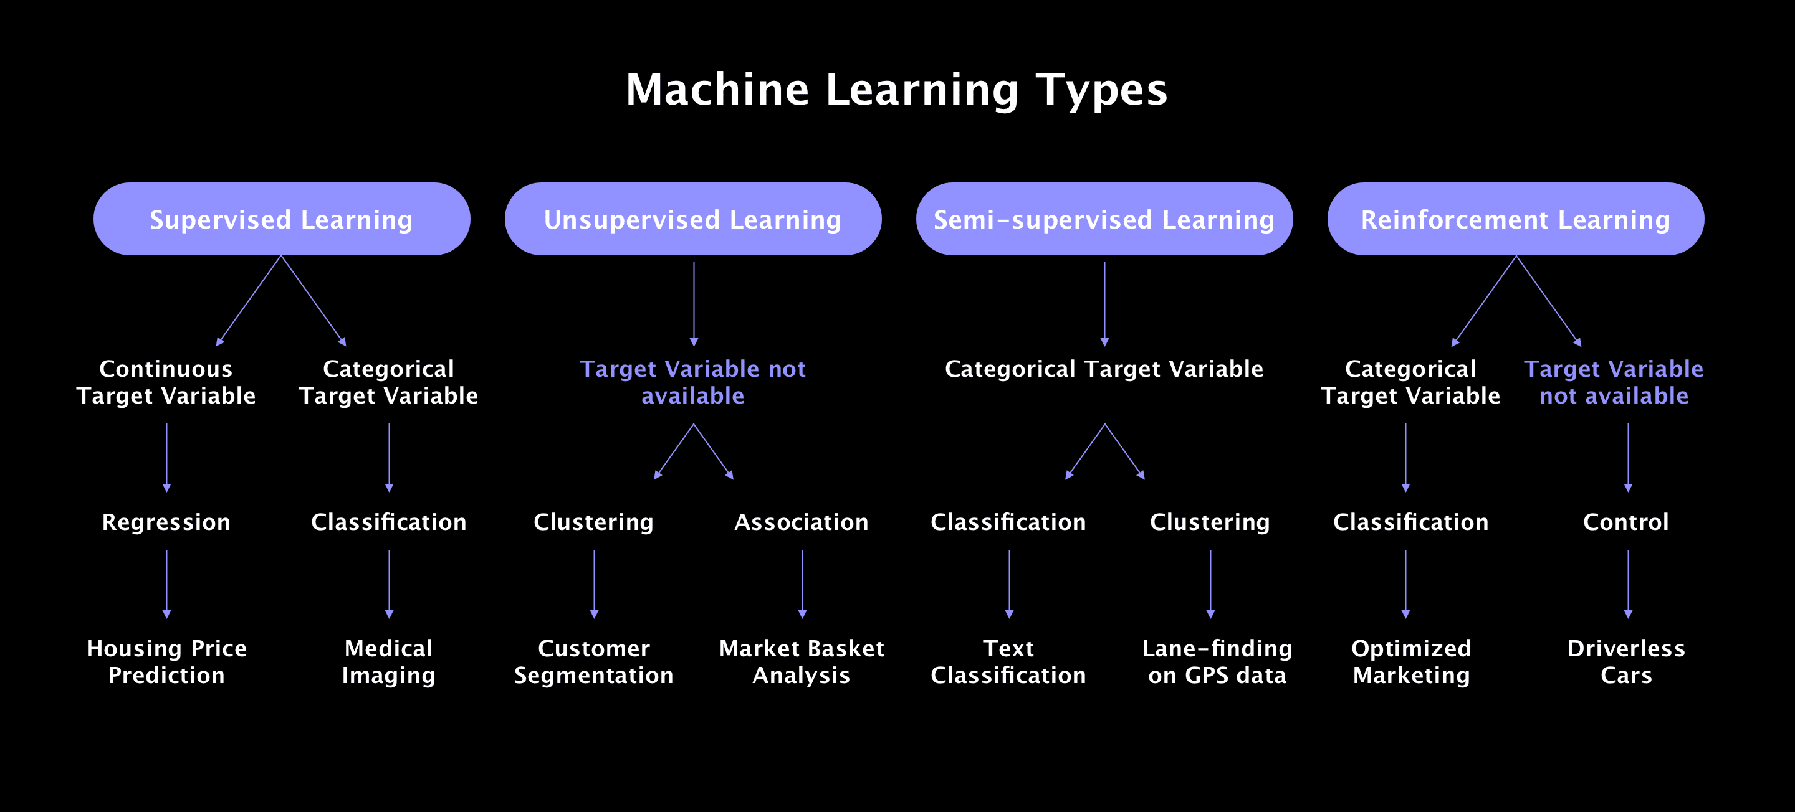
Notes:
DefinitionGrouping similar objects together based on patterns.Finding relationships between different items in a dataset.GoalIdentify natural clusters or groups within the data.Discover rules that indicate how items are associated with each other.Type of LearningUnsupervised Learning.Unsupervised Learning.Key AlgorithmsK-Means, DBSCAN, Hierarchical Clustering.Apriori, FP-Growth, Eclat.OutputCluster labels (e.g., customer segments).Association rules (e.g., "If X, then Y").Use CasesCustomer segmentation, anomaly detection, document categorization.Market basket analysis, recommendation systems, cross-selling strategies.
Practical Analogy: Grocery Store Example
Imagine you are the owner of a grocery store and want to analyze customer behavior.
1️⃣ Clustering (Grouping Similar Customers) You want to segment your customers into groups based on their shopping behavior.
Example:
One group buys organic food regularly.
Another group mostly buys frozen food.
A third group shops for baby products. Here, clustering helps you identify these customer segments so you can target them with personalized promotions.
2️⃣ Association (Finding Purchase Patterns) Instead of grouping customers, you want to find relationships between items they buy together.
Example:
Customers who buy bread often buy butter → ("Bread → Butter" is an association rule).
If a person buys diapers, they may also buy baby wipes. Here, association rule mining helps you understand which items are frequently bought together so you can bundle them or offer discounts.

Slide 30
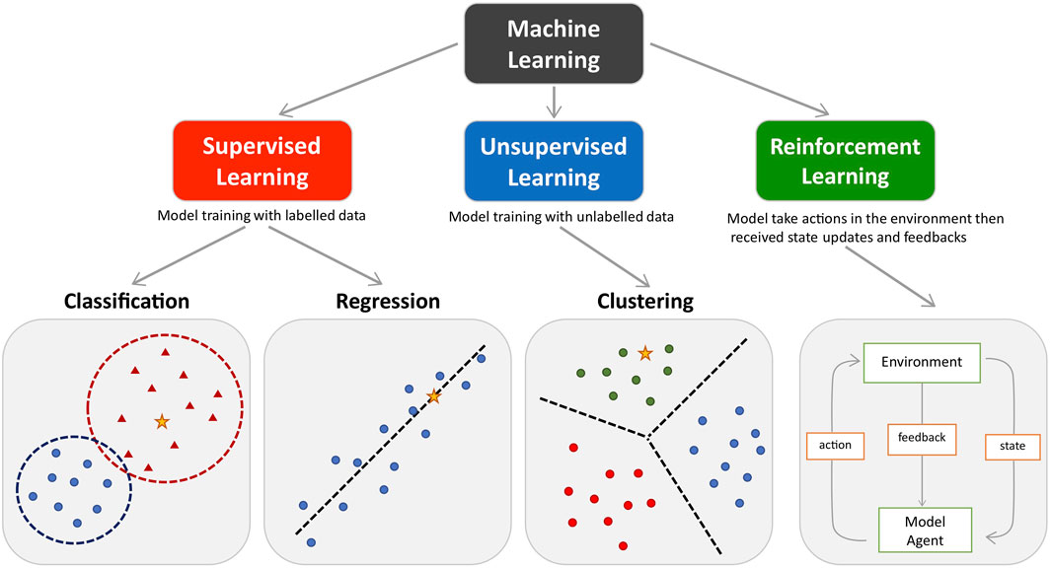
Types of problems

Slide 31
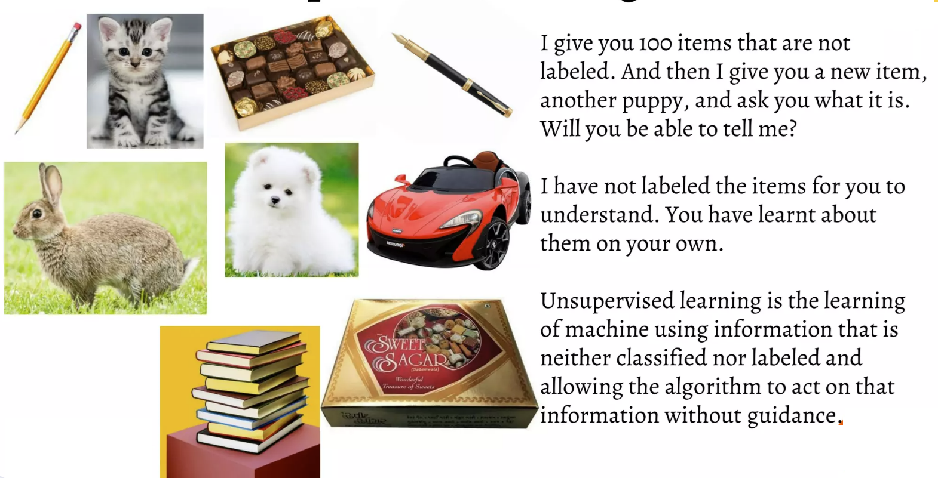
What is Unsupervised Learning?

Slide 32
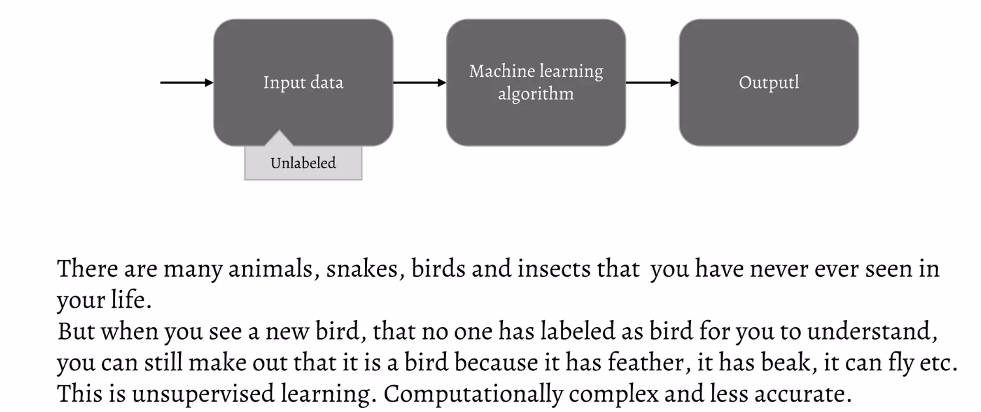
What is Unsupervised Learning

Slide 33
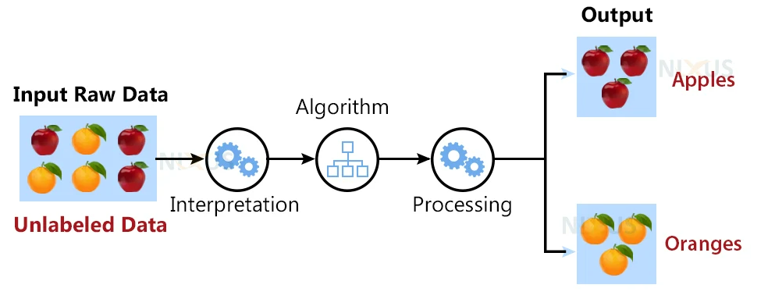
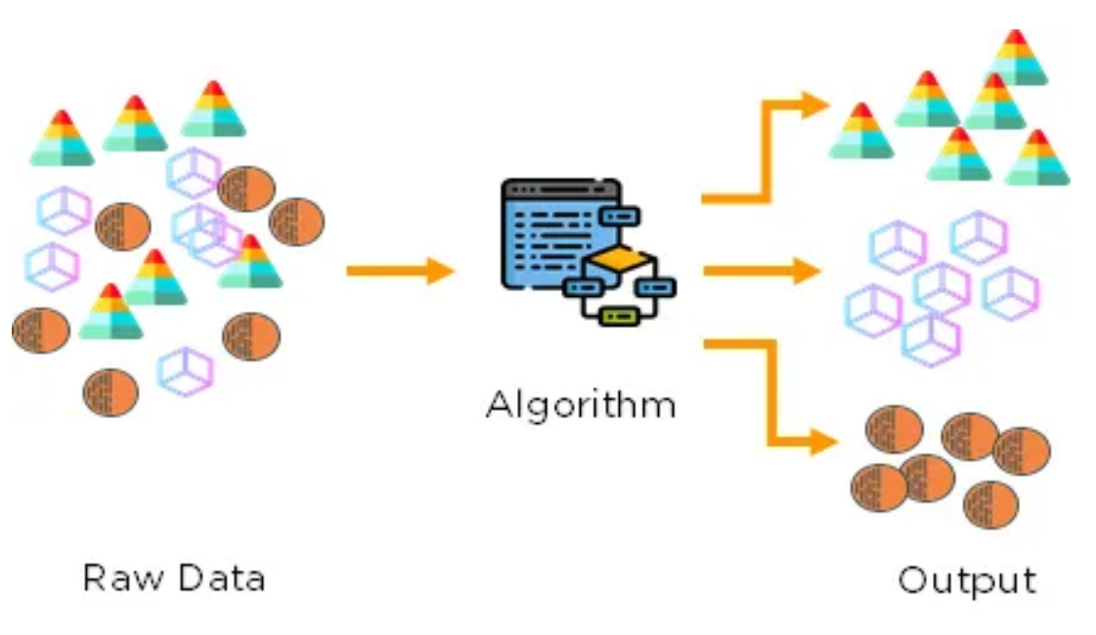
Unsupervised Learning

Slide 34
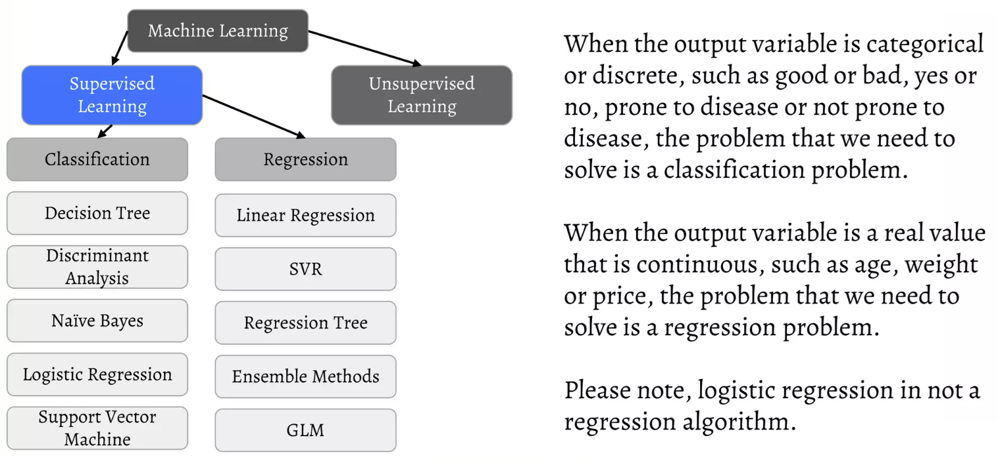
Supervised Learning: Classification vs Regression

Slide 35
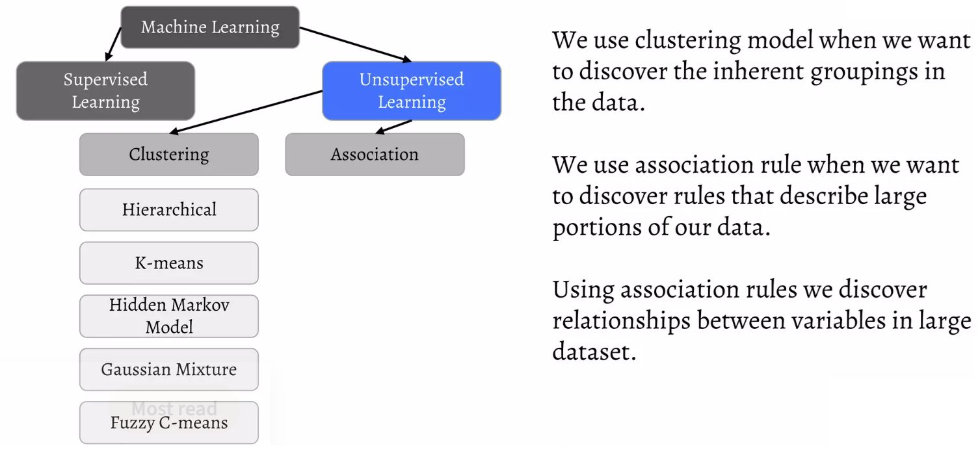
Unsupervised Learning: Clustering & Association

Slide 36
Why do we need supervised & Unsupervised learning
Supervised learning allows us to collect data or produce a data output from the previous experience.
It helps us optimize performance criteria using experience.
Supervised machine learning helps us solve various types of real-world computation problems.
Unsupervised machine learning finds all kinds of unknown patterns in data.
Unsupervised methods help us find features which can be useful for categorization.
It takes place in real time, so all the input data to be analyzed and labeled in the presence of the learners.
It is easier to get unlabeled data from a computer than labeled data because labeling of data needs manual intervention.
Notes:
https://medium.com/analytics-vidhya/awesome-machine-learning-visualizations-5208f1617ec5

Slide 37
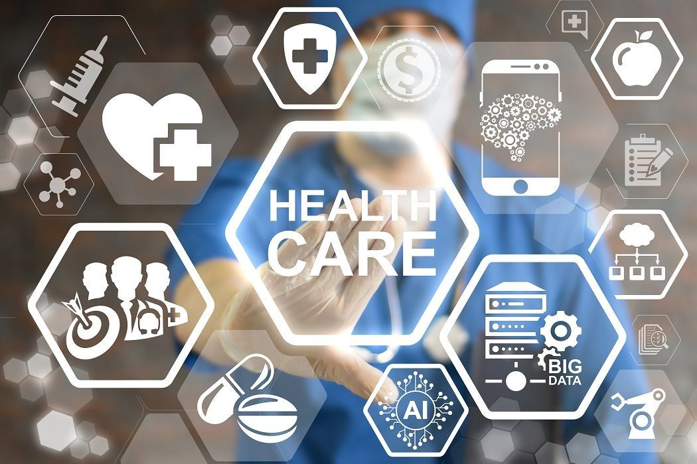
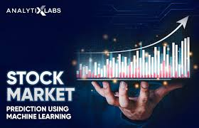
Applications
1. Healthcare
Disease Diagnosis
Example: Predict whether a patient has diabetes (Yes/No) based on factors like glucose level, age, BMI, and blood pressure.
Model Type: Logistic Regression, Decision Trees, Random Forest, Neural Networks.
Blood Pressure Prediction
Example: Predict a patient’s blood pressure based on age, weight, cholesterol levels, and activity levels.
Model Type: Linear Regression, Random Forest Regression, Neural Networks.
2. Finance & Banking
Credit Card Fraud Detection
Example: Determine if a transaction is fraudulent (Fraud/Not Fraud) based on features like transaction amount, location, and frequency.
Model Type: Decision Trees, Random Forest, XGBoost, SVM.
Stock Price Prediction
Example: Predict the price of a stock for the next day based on historical prices, trading volume, and macroeconomic indicators.
Model Type: Time Series Regression, LSTMs, ARIMA.
Notes:
Classification Problem: Disease Diagnosis
Regression Problem: Blood Pressure Prediction
Classification Problem: Credit Card Fraud Detection
Regression Problem: Stock Price Prediction

Slide 38

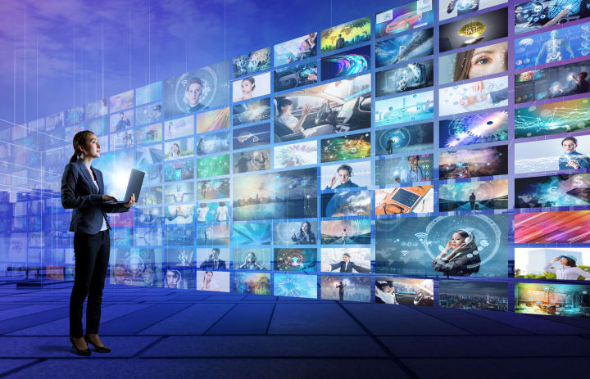
Applications
Education & Learning Systems
Student Performance Prediction
Example: Predict whether a student will pass or fail based on attendance, grades, and participation.
Model Type: Decision Trees, Random Forest, Logistic Regression.
Score Prediction
Example: Predict a student’s final exam score based on previous test scores, study hours, and attendance.
Model Type: Linear Regression, XGBoost.
Entertainment & Social Media
Movie Genre Prediction
Example: Classify a movie into genres (Comedy, Action, Horror) based on its description and cast.
Model Type: Neural Networks, Naive Bayes, Decision Trees.
User Rating Prediction
Example: Predict the rating a user will give to a movie based on their past ratings and preferences.
Model Type: Matrix Factorization, Neural Networks.
Notes:
Classification Problem: Student Performance Prediction
Regression Problem: Score Prediction
Classification Problem: Movie Genre Prediction
Regression Problem: User Rating Prediction

Slide 39
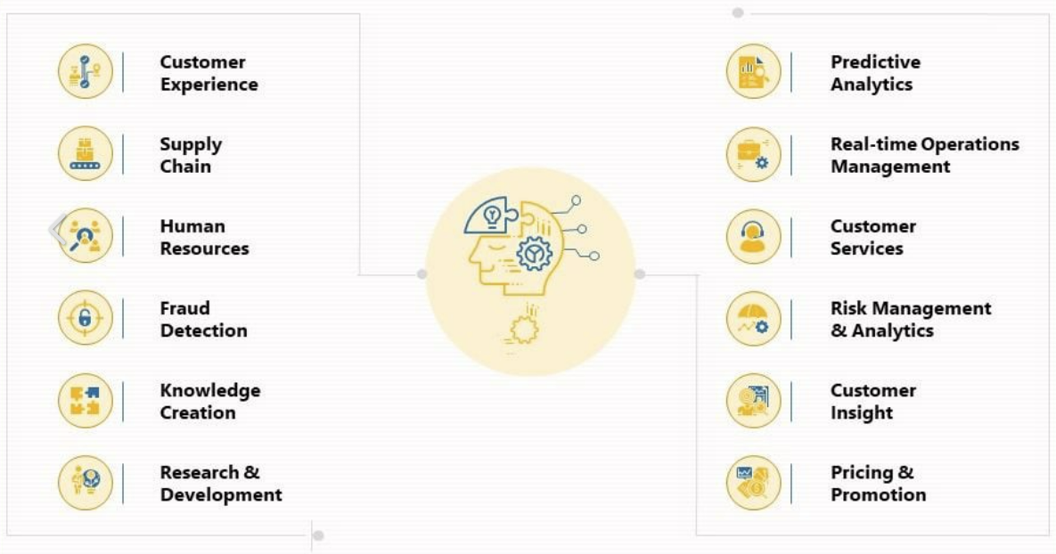
Where is AI used?
Notes:
1. Medical Imaging Analysis
Generative AI can enhance medical imaging analysis by generating high-resolution images from low-quality inputs. This technology assists radiologists in obtaining more straightforward and precise visualizations of medical scans, aiding in detecting and diagnosing diseases such as cancer, fractures, and neurological disorders.
2. Synthetic Data Generation
Training AI algorithms requires vast data, but accessing real patient information can raise privacy concerns. Generative AI can help overcome this challenge by creating synthetic data that closely mimics real-world medical data. This synthetic data can be used to train AI models effectively, without compromising patient privacy.
3. Drug Discovery
The drug discovery process can be lengthy and expensive. Generative AI accelerates this process by generating potential molecular structures with specific properties, such as drug efficacy and safety. This assists pharmaceutical researchers in identifying promising drug candidates, saving time and resources.
4. Personalized Treatment Plans
Generative AI can analyze patient data, including medical history and genetic information, to create personalized treatment plans. By considering individual variations, AI can suggest optimized treatment options with a higher likelihood of success and fewer side effects.
5. Disease Progression Modeling
Understanding how diseases progress is essential for effective treatment and patient management. Generative AI can simulate disease progression models based on historical patient data, enabling medical professionals to anticipate disease patterns and improve decision-making.
6. Medical Text Generation
Generating accurate medical reports and summaries can be time-consuming for healthcare providers. Generative AI can automate this process by generating detailed medical texts based on patient data and clinical findings, enhancing the efficiency of medical documentation.
7. Augmented Reality for Surgery
Incorporating Generative AI with augmented reality (AR) technology allows surgeons to access real-time guidance during complex procedures. AR overlays generated by AI in the surgical field can display critical information, such as organ structures and blood flow, assisting surgeons in making precise decisions.
8. Mental Health Support
Generative AI can contribute to mental health care by generating virtual assistants that simulate human-like conversations. These AI companions can provide round-the-clock support, monitor patients’ emotional well-being, and offer appropriate responses or interventions.
9. Rehabilitation and Prosthetics
Generative AI-powered exoskeletons and prosthetics can be tailored to individual patients’ needs. By analyzing movement patterns and medical history, AI can design personalized assistive devices that enhance mobility and improve the quality of life for individuals with physical disabilities.
10. Predictive Analytics
Generative AI can aid in predictive analytics for various healthcare scenarios. By analyzing vast amounts of patient data, AI can predict disease outbreaks, patient readmissions, and other critical events, allowing healthcare facilities to be better prepared and allocate resources more efficiently.
AI in Retail and E-commerce
Personalized Product Recommendations
AI-driven recommendation engines personalize every customer’s shopping journey across websites, mobile apps, email, digital ads, and in-stores.
These systems analyze behavioral signals like browsing activity, purchases, clicks, swipes, and product views to surface the most relevant recommendations for each shopper dynamically.
When customers receive AI-tailored recommendations for items they’re truly interested in, it boosts engagement, conversions, average order value, and lifetime loyalty.
AI’s self-learning algorithms get smarter at personalizing experiences over time and with more data.
Demand Forecasting & Dynamic Pricing
Fueled by machine learning predictions, retailers use AI systems to produce accurate forecasts for future product demand based on complex data inputs like sales histories, inventory levels, pricing details, promotional calendars, economic factors, and others.
Combining demand forecasts with real-time market data empowers dynamic pricing models to automatically adjust sticker prices up or down to maximize revenue potential, clear aging stock, or remain competitive.
AI also guides promotion planning and markdown cadence decisions.
AI in Manufacturing
Predictive Maintenance
By continuously monitoring Internet of Things (IoT) sensor data from factory equipment and production line machinery, AI systems can predictively determine when assets will likely require repair or replacement to avoid unexpected downtime incidents.
Predictive alerts provide time to schedule maintenance proactively at opportune times rather than reactively after breakdowns occur.
Automated Quality Control
Computer vision AI is enhancing quality assurance and quality control measures across manufacturing by automatically inspecting products, components, asset conditions, and processes for defects in real time at superhuman scales.
High-resolution cameras integrated with machine learning models rapidly detect even minuscule surface imperfections, dents, cracks, contaminations, or missing pieces that may have passed by human quality inspectors.
AI vision empowers 100% automated inspection for quality standards traceability.
Autonomous Vehicles and Mobility
While not yet mainstream, autonomous vehicles and mobility solutions enabled by AI are actively being developed and tested across passenger transportation, trucking, and last-mile delivery domains.
AI computer vision models interpret real-time visual data from cameras and sensors to identify obstacles, traffic signals, pedestrians, and environmental conditions.
Machine learning handles the core navigation and vehicle control decision systems to dynamically plan paths and operate vehicles safely without human intervention.
Beyond technological milestones, AI will also power mobility services by coordinating fleets of autonomous trucks, taxis, and delivery vehicles through intelligent routing and traffic pattern optimization.
Understanding what industries use artificial intelligence helps identify opportunities for innovation and optimization.
Personalized Learning
Through machine learning and data analysis, AI systems can dynamically adapt educational content delivery, pacing, teaching styles, and learning activities to align with each student’s needs, aptitudes, and optimal learning pathways. That’s why AI in personalized learning is no longer a dream.
AI tutoring systems provide infinite patience, assessing knowledge gaps and strengths to customize curricula and recommend supplementary resources.
AI virtual teaching assistants offer 24/7 on-demand homework support tailored to how each student learns best.
Automated Grading and Feedback
Using AI for automated grading and feedback alleviates tedious workloads for educators.
Machine learning models can score tests, essays, programming assignments, and other subjective work as accurately as human graders.
But AI goes beyond just scores – it provides detailed, tailored feedback highlighting areas for improvement and explaining the rationale behind scoring decisions.
This scalable approach keeps teachers focused on higher-level tasks.
The integration of AI use cases in major industries is accelerating digital transformation solutions, enabling organizations to stay competitive in today’s rapidly evolving market.

Slide 40
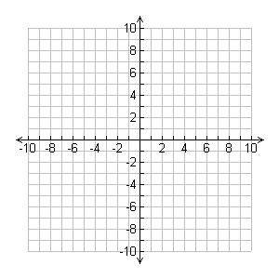
Linear Regression
x | y
0 | 2
2 | 6
4 | 10
6 | 14

Slide 41


Introduction to Linear Regression

Slide 42





Plotting Data Points
Plotting Data Points

Slide 43




Finding the Best Fit Line

Slide 44





Understanding Linear Regression Line

Slide 45

Understanding R²: Variance Explained by the Model

Slide 46

Error Calculation and Loss Function

Slide 47

When R² = 0: No Predictive Power

Slide 48

Notes:
What is Artificial Intelligence?
Types of Intelligence
Where is AI used?
Introduction to machine learning
How exactly we recognize things
How to make machines to learn things
How does Machine Learning Work?
Machine Learning Types
Types of problems
Supervised Machine Learning
Unsupervised Machine Learning
Why do we need supervised & Unsupervised learning

